Slide 1
SW Education Training
for Cambodia Teacher
SW Education for Raspberry pi
- First Lession : Setting up raspberry pi
Lecturer : Kim Ki Tae
(taesamja12345@gmail.com)

Slide 2
[ Contents ]
0. Software Education
1. Raspberry Pi ?
2. Setting up raspberry pi

Slide 3





0. Software Education
Traditional Hardware Industry
Software Industry

Slide 4

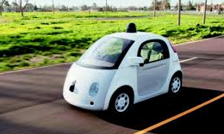

0. Software Education
Notes:
A.I.(Artificial Intelligence), Self-Driving Car, Robot

Slide 5
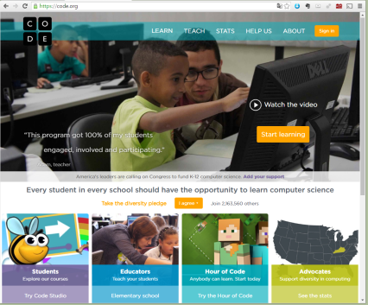
0. Software Education
US President Barack Obama speech for SW Education
Code.org

Slide 6
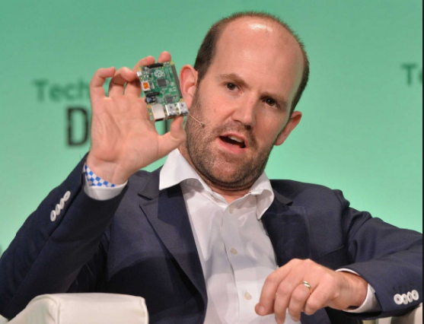
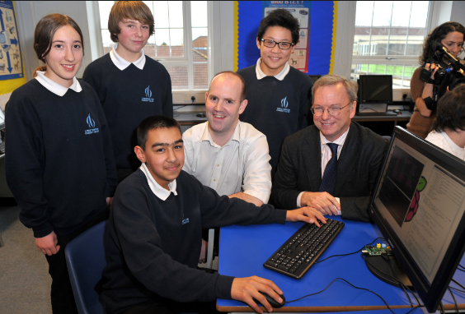
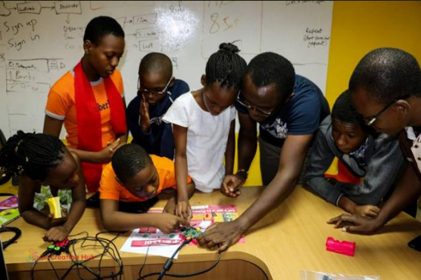
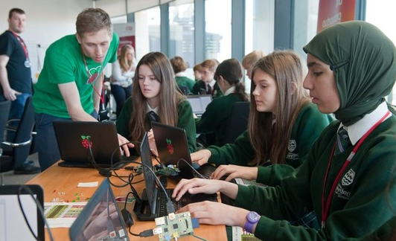
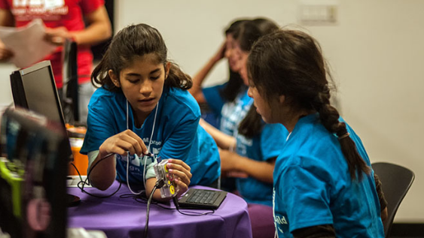
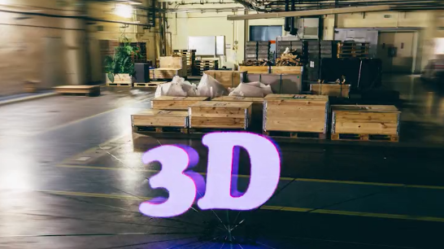
1. Raspberry pi ?
- a low cost, credit-card sized computer
- starting at educational purposes
The Raspberry Pi Foundation is a registered educational charity based in the UK.
The goal is to advance the education of adults and children,
particularly in the field of computers, computer science and related subjects.
Eben Upton ,
Raspberry Pi Founder
the Raspberry Pi has the ability
to interact with the outside world,
and has been used in a wide array
of Digital maker projects,
from music machines and parent detectors
to weather stations
and tweeting birdhouses
with infra-red cameras. etc…

Slide 7
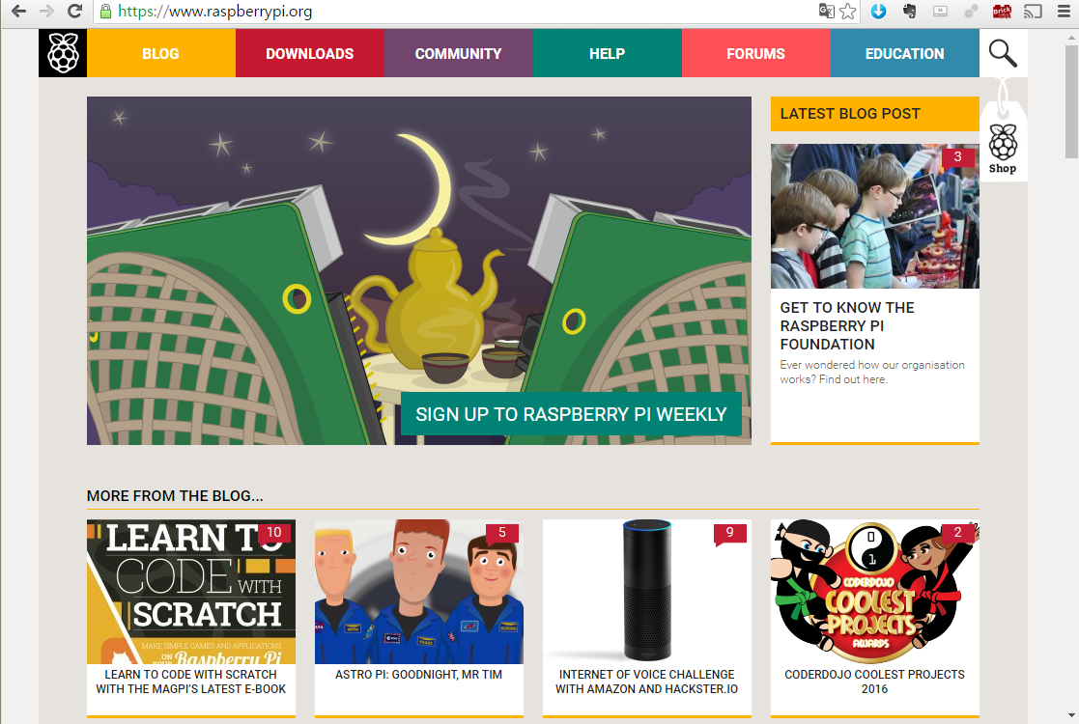
http://www.raspberrypi.org

Slide 8
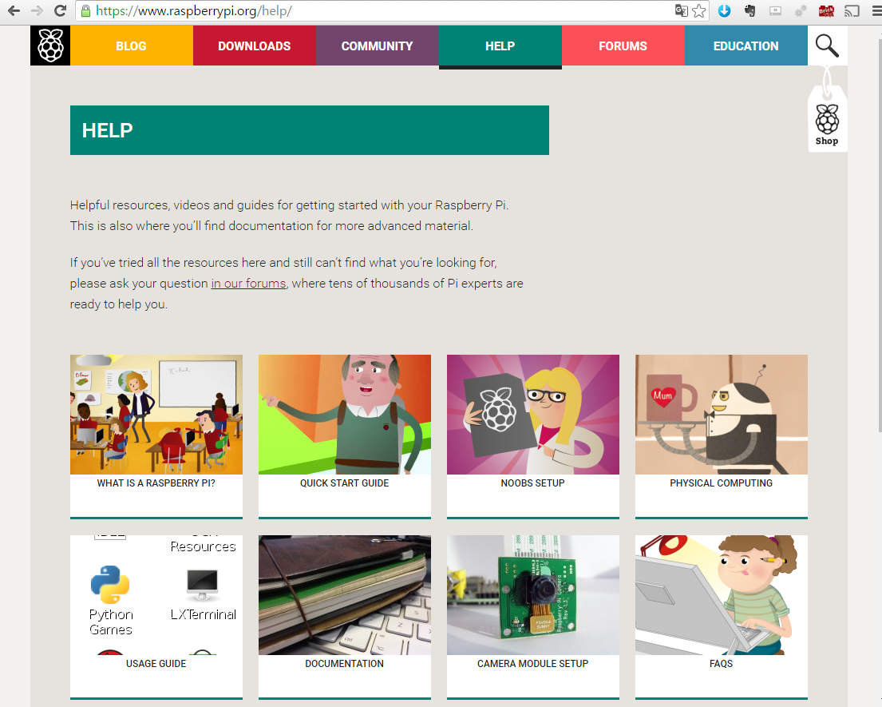
http://www.raspberrypi.org/help/

Slide 9
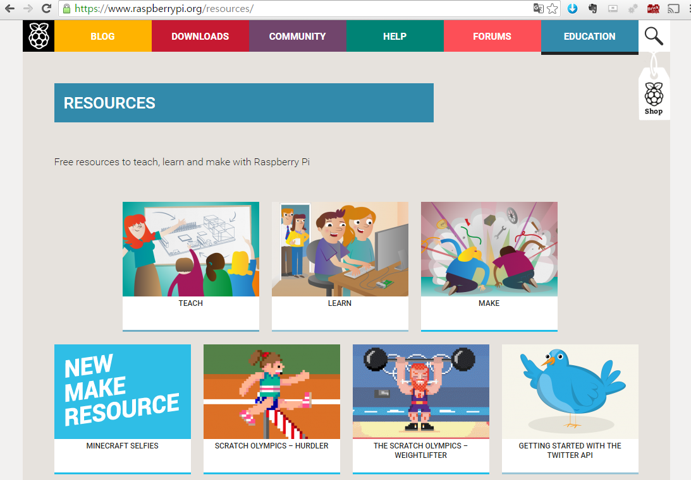
http://www.raspberrypi.org/resources/

Slide 10
2. Setting up raspberry pi
Materials
Installation Steps
Applications

Slide 11
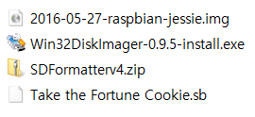
Materials
SW : Materials
confirm material lists of your usb card

Slide 12
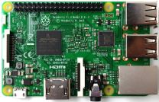
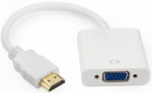
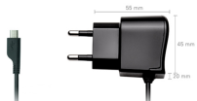
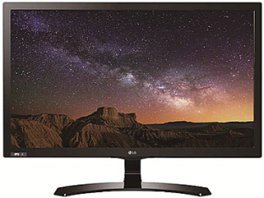
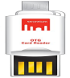
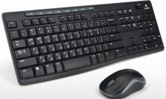
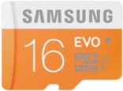
Materials
HW : Materials
Hdmi to vga converter
Raspberry pi 3
Power Cable
MicroSD Adapter of
usb type
Vga Monitor
Keyboard & Mouse
of usb type
MicroSD 16G

Slide 13
Installation Steps
Installation Steps - Ⅰ
Installation Steps – Ⅱ
Installation Steps - Ⅲ
Installation Steps - Ⅳ

Slide 14
Installation Steps -Ⅰ
1. Install sd formatter program after decompressing sdformatter.zip file.
2. Install Win32DiskImager program.
3. Insert usb reader to Windows Desktop usb slot
after you connect MicroSD card to Usb Reader.
4. Format MicroSD card using sdformatter program.
5. Write Raspian Image in the formatted MicroSD card using
Win32DiskImager program.

Slide 15
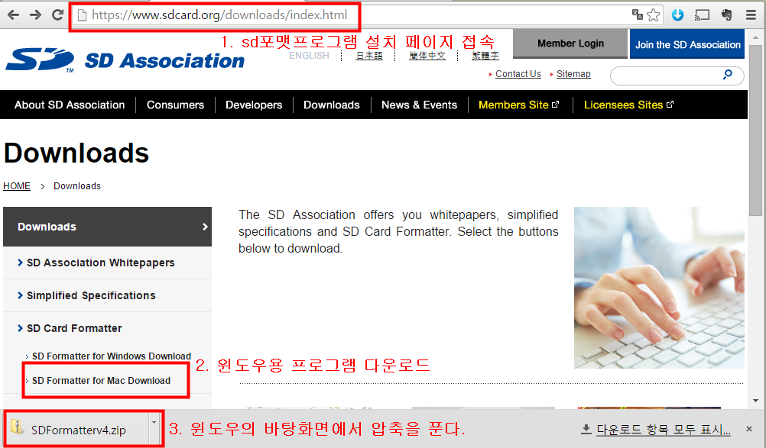
1. Install sd formatter program after decompressing sdformatter.zip file.
Use SD Formatter download Site
https://www.sdcard.org/downloads/index.html

Slide 16
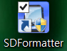
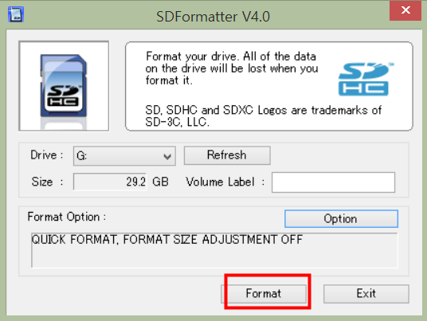
SDFormatter Install

Slide 17
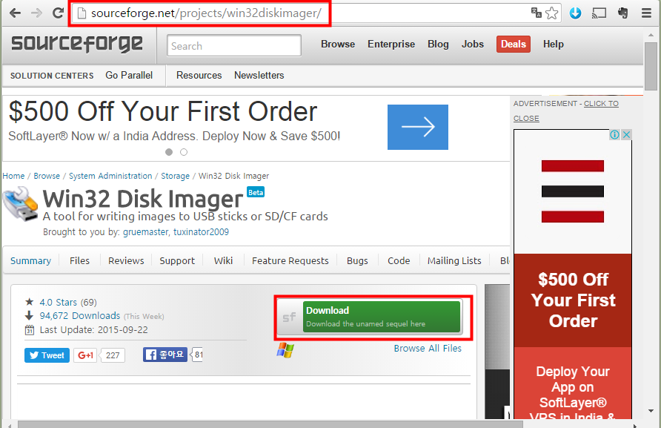
2. Install Win32DiskImager program.
Win32DiskImager download Site
http://sourceforge.net/projects/win32diskimager/

Slide 18
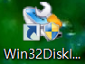
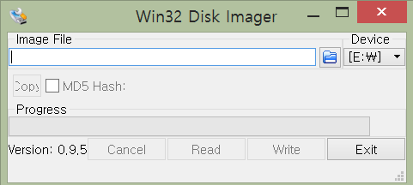
Win32DiskImager Install

Slide 19
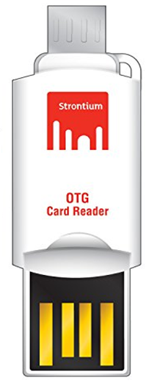

3. Insert usb reader to Window’s Desktop usb slot after you connect
MicroSD card to Usb Reader.

Slide 20
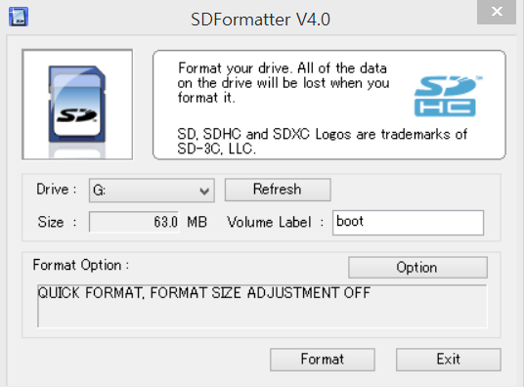
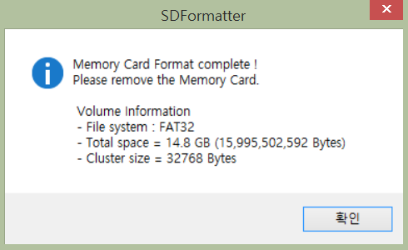
4. Format MicroSD card using sdformatter program.

Slide 21
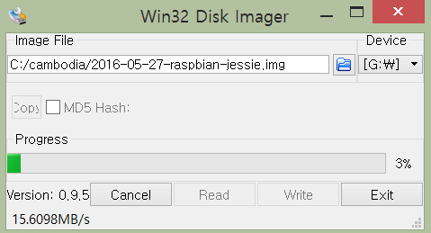
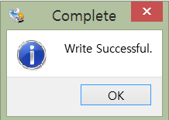
5. Write Raspian Image in the formatted MicroSD card using
Win32DiskImager program.

Slide 22
Installation Steps - Ⅱ
Change “config.txt” file content in boot derectory of MicroSD card
Using window’s wordpad text editor.
< chaged code line >
Hdmi_force_hotplug = 1
Hdmi_group = 2
Hdmi_mode = 16 (1024x768)
Hdmi_drive = 1
Reason for this step
: Setting of hdmi-to-vga converter
If monitor cable is only hdmi type,
the front of changed code line
enter ‘#’ character.
2. Copy the “take the fortune cookie.sb” file of usb memory card
to boot directory in MicroSD card.
Reason for this step
: scratch lession for data file
3. Eject MicroSD card from window usb slot.

Slide 23
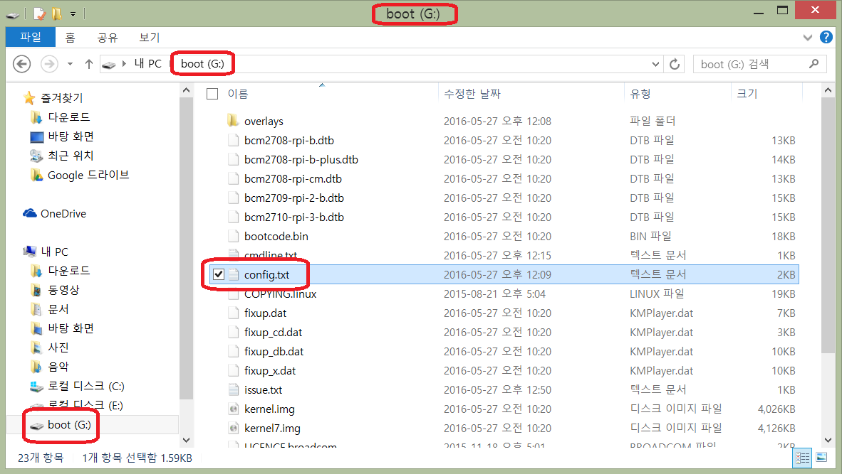
1. Change “config.txt” file content in boot derectory of MicroSD card
Using window’s wordpad text editor.

Slide 24
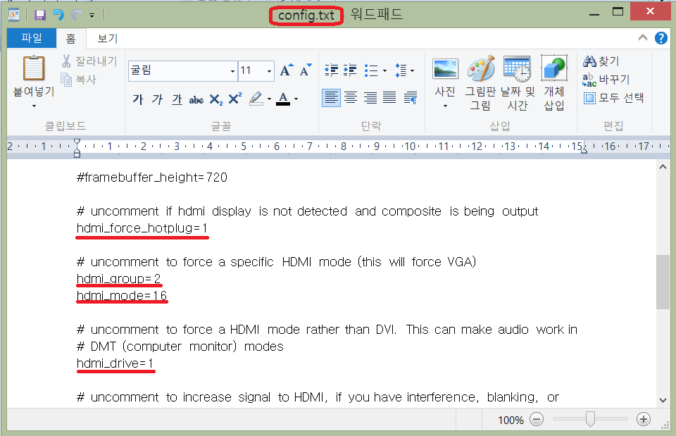
< changed code line >
Hdmi_force_hotplug = 1
Hdmi_group = 2
Hdmi_mode = 16 (1024x768 60Hz)
Hdmi_drive = 1
More Settings are in website
of http://elinux.org/RPi_config.txt .

Slide 25
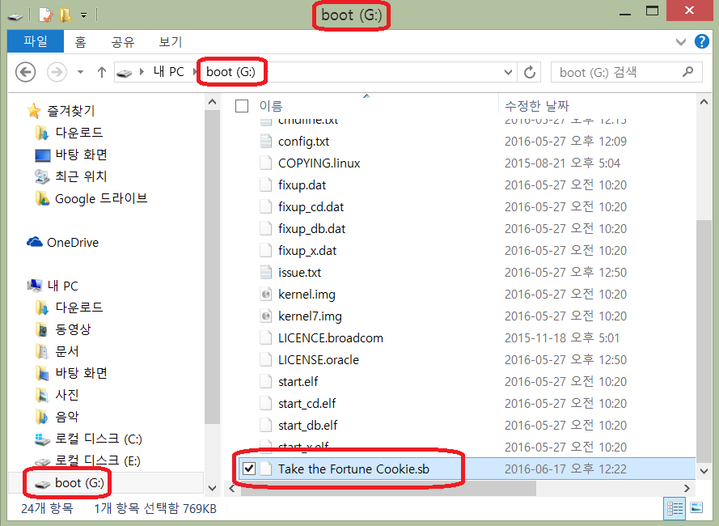
2. Copy the “take the fortune cookie.sb” file of usb memory card
to boot directory in MicroSD card.

Slide 26
3. Eject MicroSD card from window’s desktop usb slot.

Slide 27
Installation Steps - Ⅲ
1. Insert MicroSD card to usb slot of Raspberry pi.
2. Connect keyboard and mouse to usb slot of Raspberry pi.
3. Connect cable using hdmi to vga converter
between raspberry pi hdmi slot and vga monitor.
4. Boot after connecting power cable to Raspberry pi.
5. Finally, the vga monitor show Raspberry pi boot logo.
6. After you execute scratch program and open “take the fortune cookie.sb”
file in boot directory of Raspberry pi, confirm the next lession project.

Slide 28

1. Insert MicroSD card to usb slot of Raspberry pi.

Slide 29
2. Connect keyboard and mouse to usb slot of Raspberry pi.

Slide 30
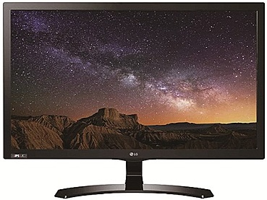

3. Connect cable using hdmi to vga converter
between raspberry pi hdmi slot and vga monitor.

Slide 31
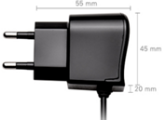
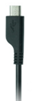
4. Boot after connecting power cable to Raspberry pi.

Slide 32
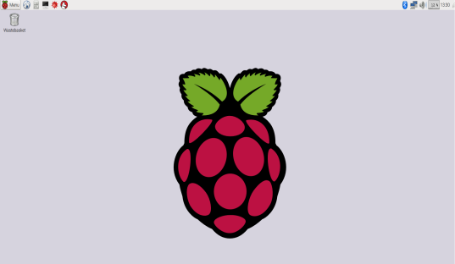
5. Finally, the vga monitor show Raspberry pi boot logo.

Slide 33
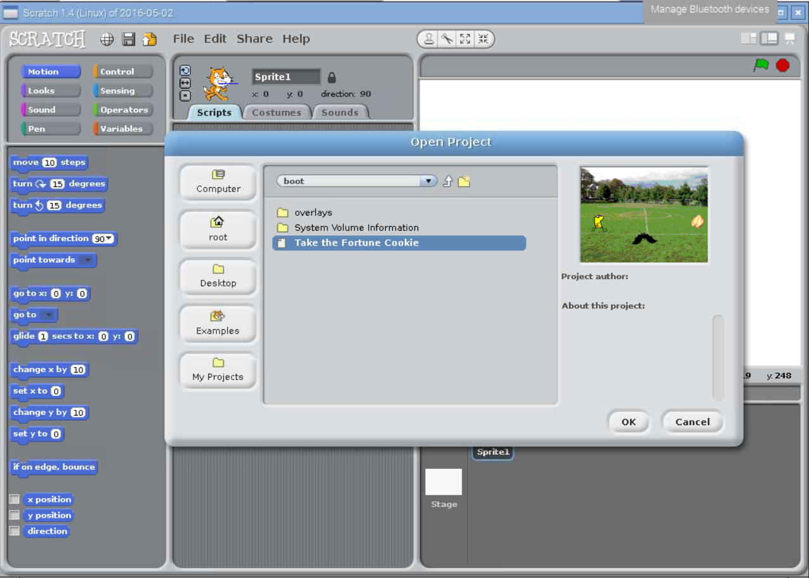
6. After you execute scratch program and open “take the fortune cookie.sb”
file in boot directory of Raspberry pi, confirm the next lession project.

Slide 34
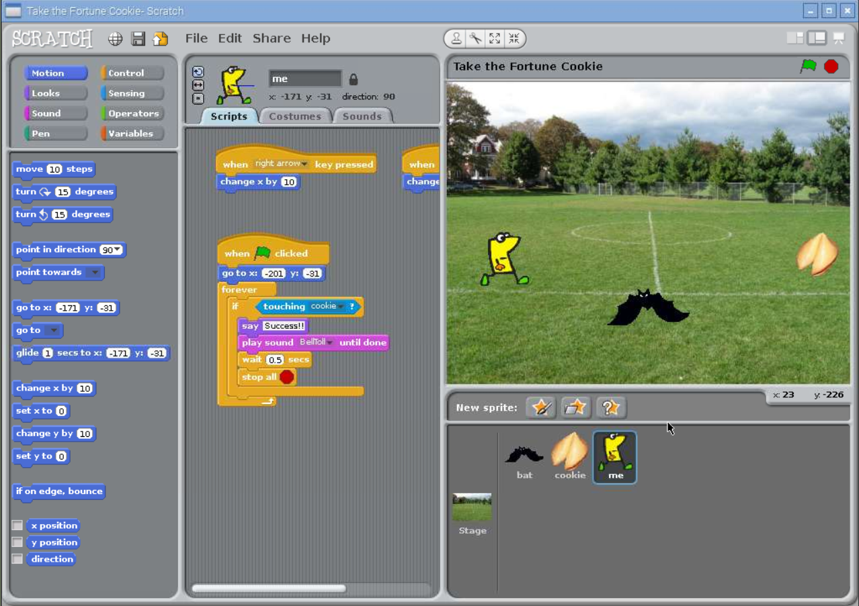

Slide 35
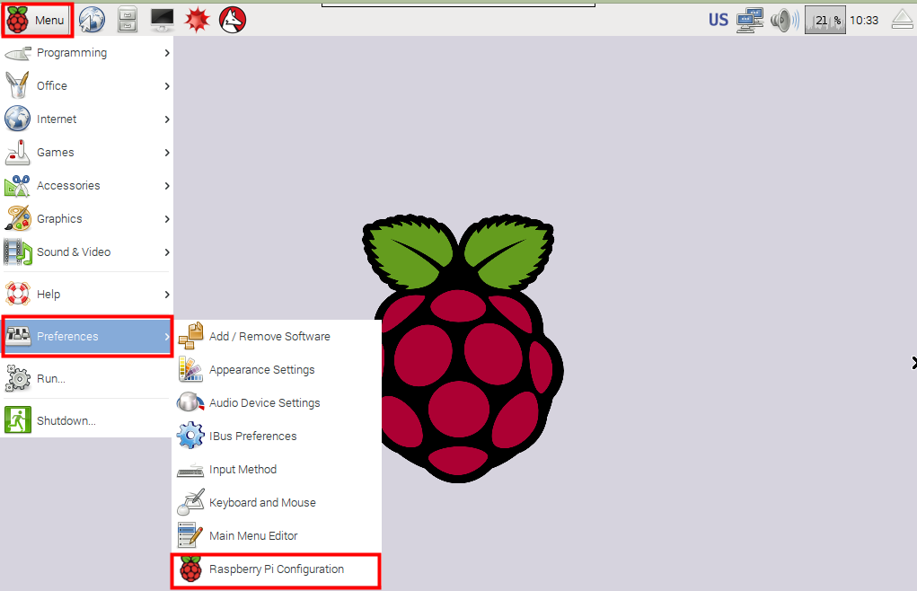
Installation Steps - Ⅳ
Raspbian Preferences

Slide 36
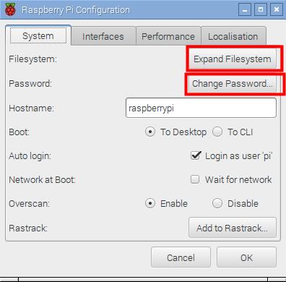
1. Expand Filesystem & Change Password

Slide 37
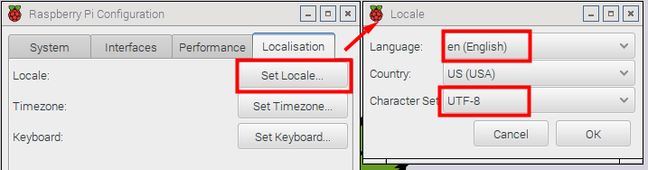
2. Setting Locale

Slide 38
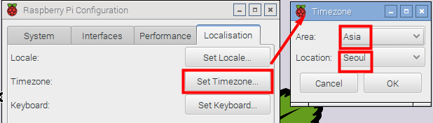
3. Setting Timezone

Slide 39
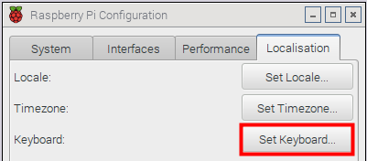
4. Setting Keyboard
Country : Korean
Variant : Korean 104 Key

Slide 40
Applications
Basic - Programming
Other - Piwall
Basic - Offices
Other - GPIO
Basic - Games
Other - Kodi
Basic – System Program
Other - RetroPi

Slide 41
Basic
Programming
Offices
Games
System Program

Slide 42





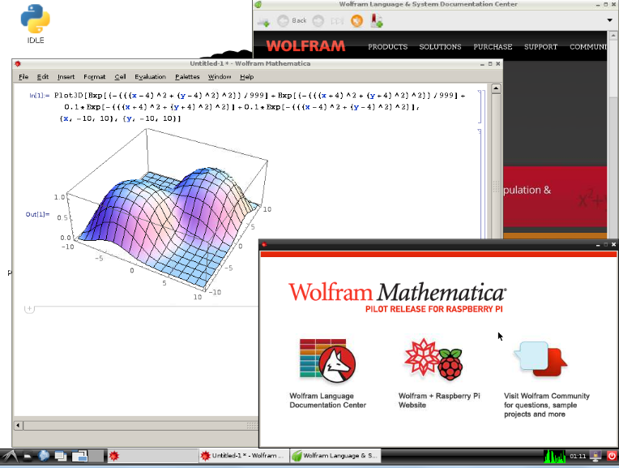


Basic - Programming

Slide 43
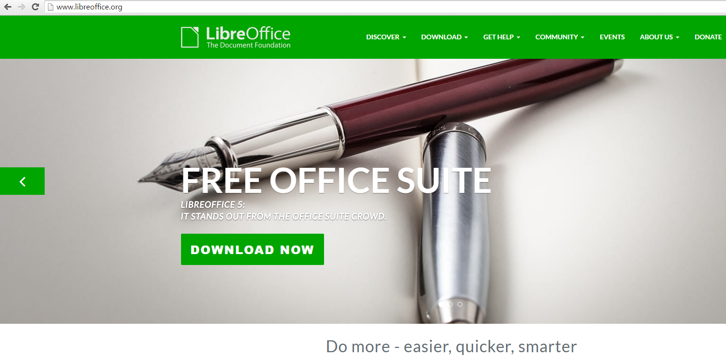
Basic - Offices
Libre Office Group : Excel, Word, PowerPoint, etc…

Slide 44
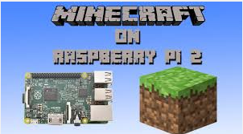
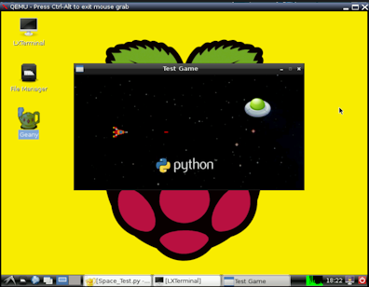
Basic - Game
MineCraft, Pygame etc…

Slide 45
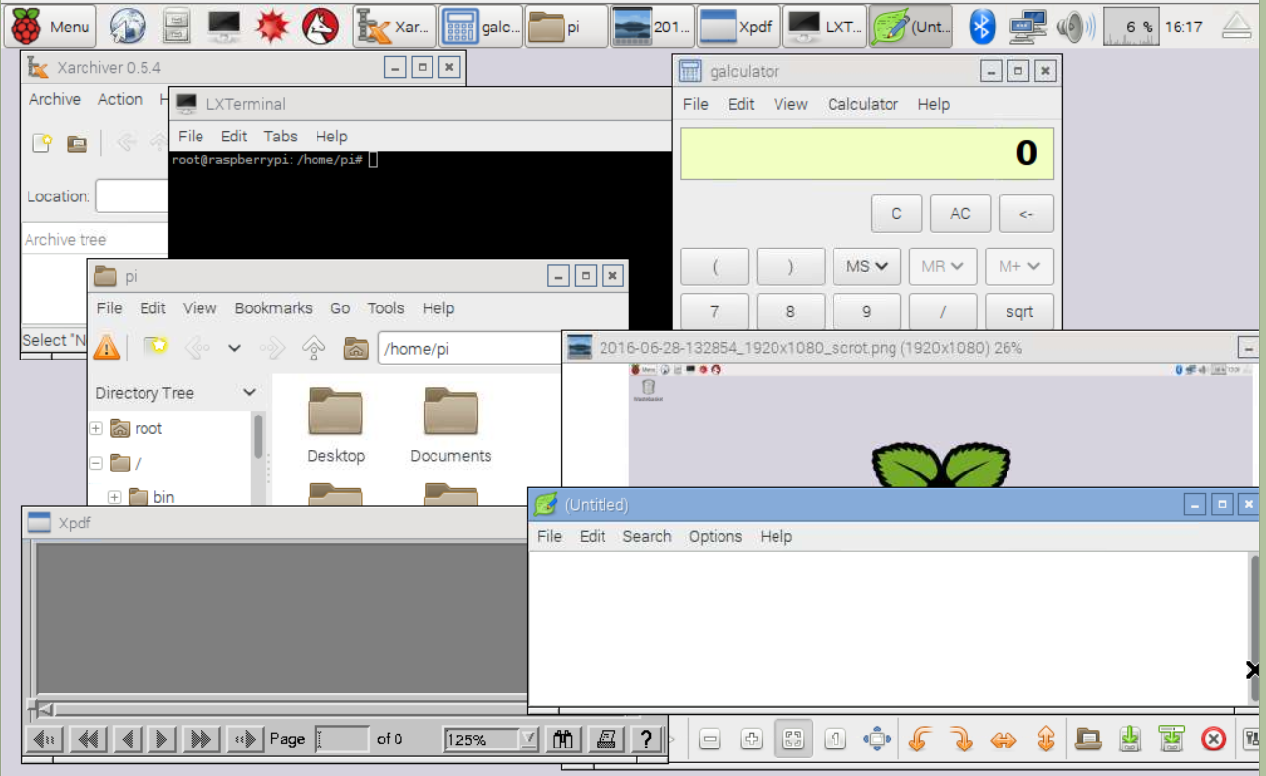
Basic – System Program
Archive, Calculator, File explorer, Image viewer, Pdf viewer, etc…

Slide 46
other
Piwall
GPIO
Kodi
RetroPi

Slide 47
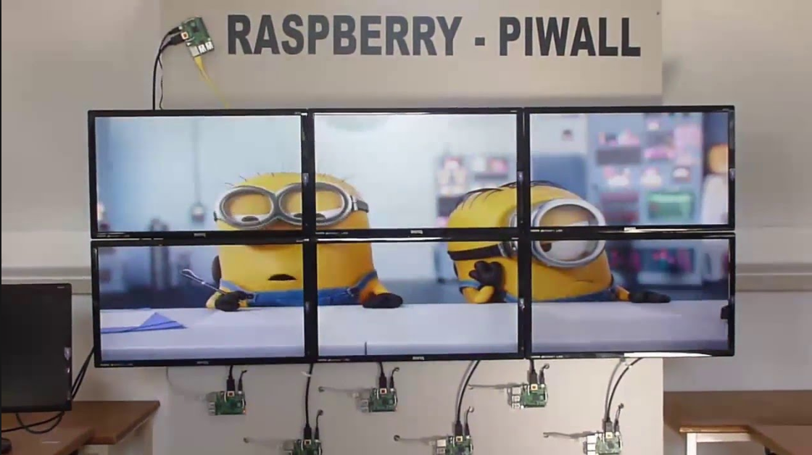
Other - Piwall
Example : link

Slide 48

Other - GPIO

Slide 49

Other -Kodi

Slide 50

Other – RetroPi

Slide 51
Thank you
for listenning first Lession
The End : Setting up raspberry pi
Next Lession is Scratch Introduction~~~

